Slide 1

Undoing Changes

Slide 2
Undoing Changes
But what happens when we make a mistake or wish to undo an action?
Or what if we wish to explore some historical commits?

Slide 3
Undoing Changes
Solution:
git checkout and Detached HEAD
git restore
git reset
git revert

Slide 4
Git Checkout

Slide 5
Undoing Changes
git checkout
A "checkout" is the act of switching between different versions of a target entity.
The git checkout command can operate on three distinct entities: files, commits, and branches.

Slide 6
Undoing Changes
git checkout
For example, you could use git checkout branch_name instead of git switch branch_name to checkout a new branch.
Unlike git switch however, recall checkout can operate on commits, meaning we can “checkout” historical commits.

Slide 7
Undoing Changes
git checkout
We can check out a particular commit by specifying its hash, we can get hashes from the git log command and we can also see the abbreviated hash using:
git log --oneline
Then we can provide the has as:
git checkout #######

Slide 8
Undoing Changes
Typically our HEAD points to the branch which points to the latest commit.
HEAD
Master
d34v8fh
a9jd3h7
vh2n38

Slide 9
Undoing Changes
Upon calling git checkout a9jd3h7 we detach the HEAD to a previous commit
HEAD
Master
d34v8fh
a9jd3h7
vh2n38

Slide 10


Day 4 Undoing Changes
You can think of this as traveling back in history to what your code looked like when you ran this commit.
HEAD
Master
d34v8fh
a9jd3h7
vh2n38

Slide 11
Day 4 Undoing Changes
This command does not undo previous work, you are simply exploring the historical commit.
HEAD
Master
d34v8fh
a9jd3h7
vh2n38

Slide 12
Day 4 Undoing Changes
If you started making changes here, they won’t be preserved since HEAD is not pointing at a branch reference.
HEAD
Master
d34v8fh
a9jd3h7
vh2n38

Slide 13
Day 4 Undoing Changes
However you could create a new branch at this point in time, reattaching HEAD to a branch again.
HEAD
Master
d34v8fh
a9jd3h7
vh2n38

Slide 14
Day 4 Undoing Changes
However you could create a new branch at this point in time, reattaching HEAD to a branch again.
HEAD
New
Master
d34v8fh
a9jd3h7
vh2n38

Slide 15
Day 4 Undoing Changes
However you could create a new branch at this point in time, reattaching HEAD to a branch again.
New
HEAD
ch2n3d
Master
d34v8fh
a9jd3h7
vh2n38

Slide 16
Day 4 Undoing Changes
Let’s explore these commands in practice!

Slide 17
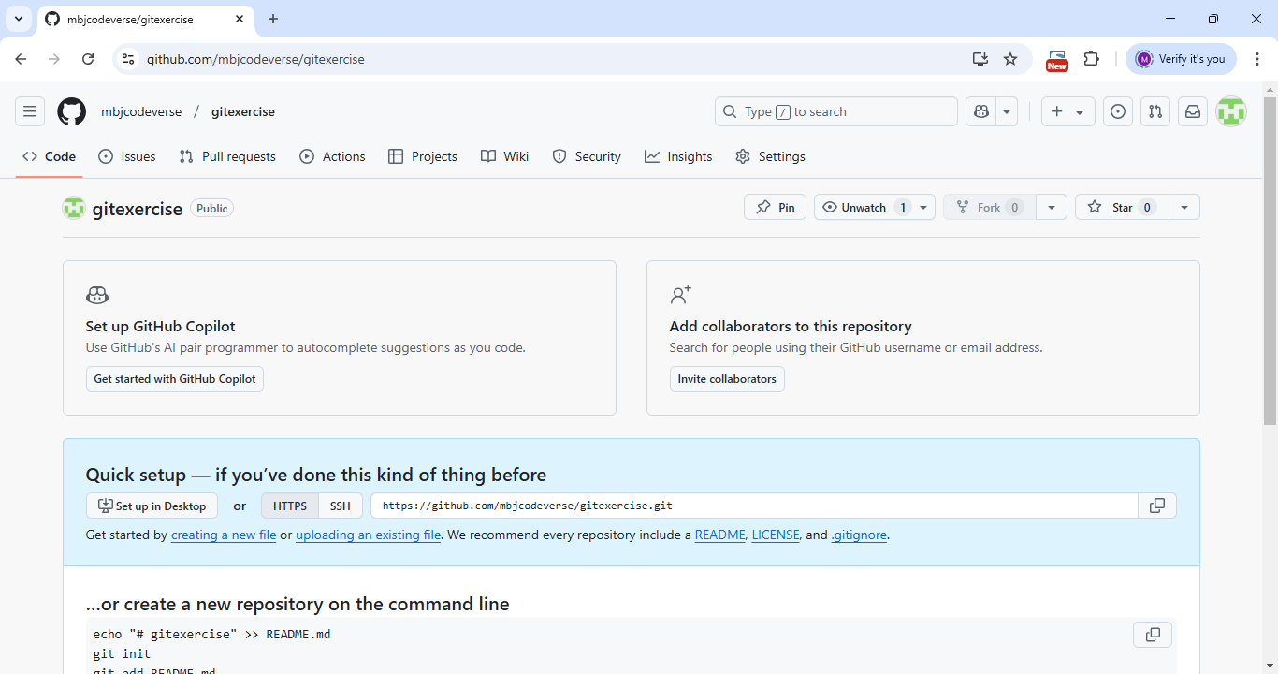

Slide 18
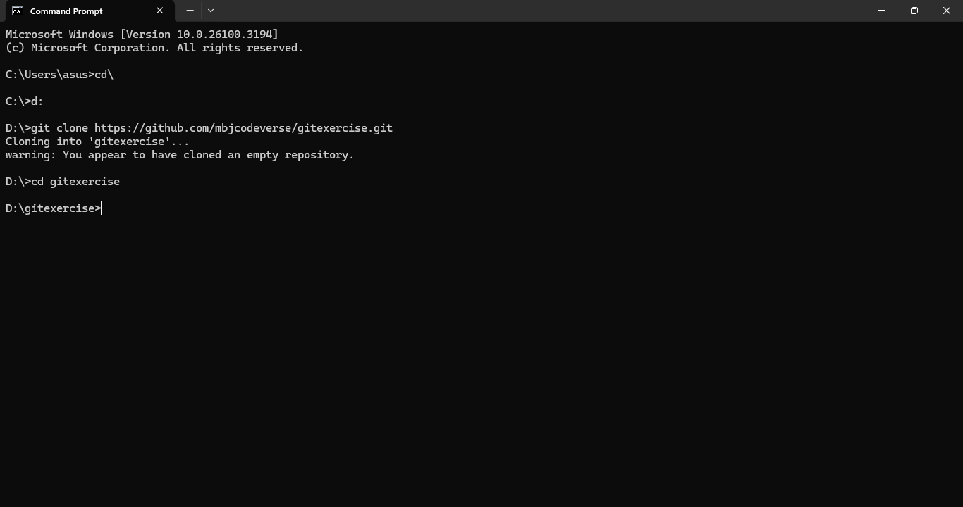

Slide 19
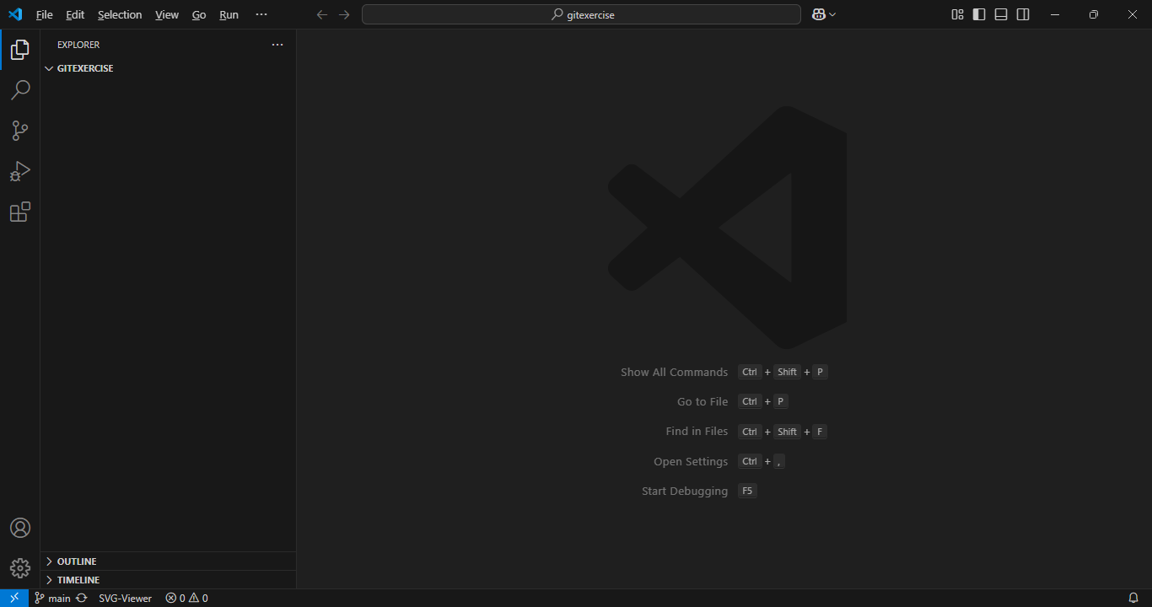

Slide 20
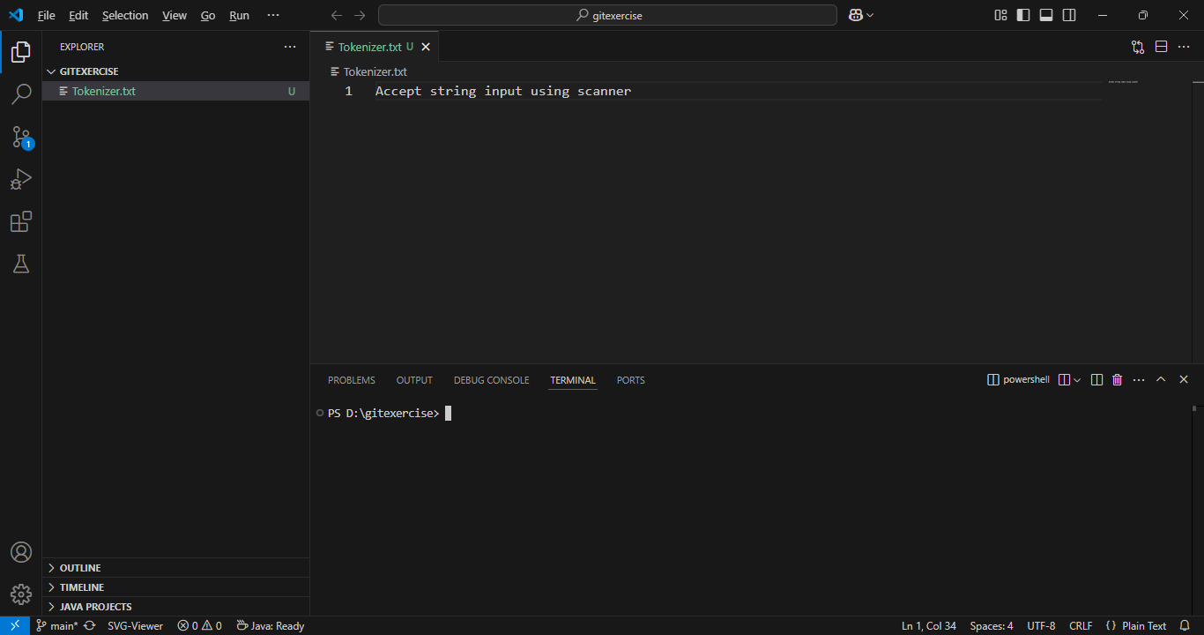

Slide 21
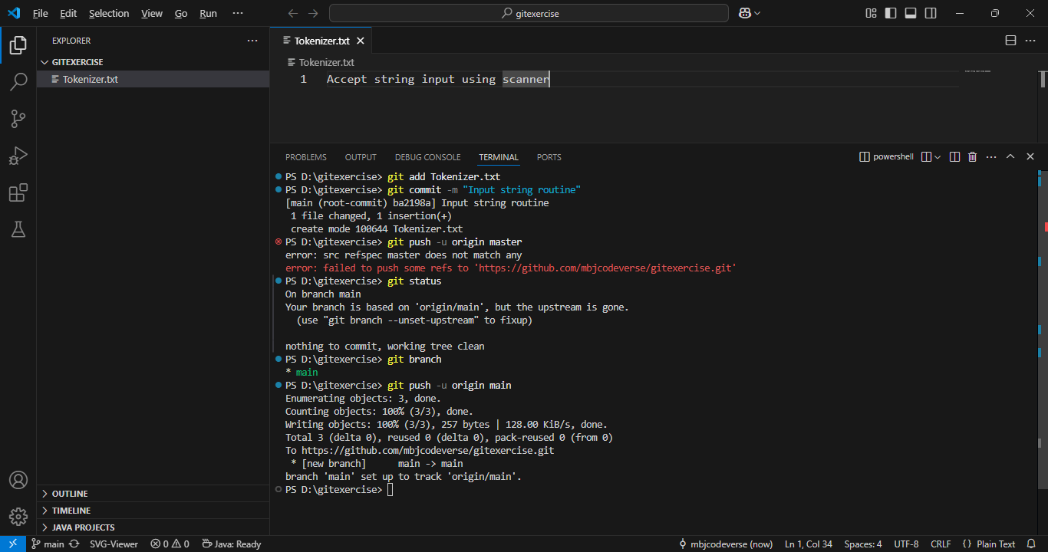

Slide 22
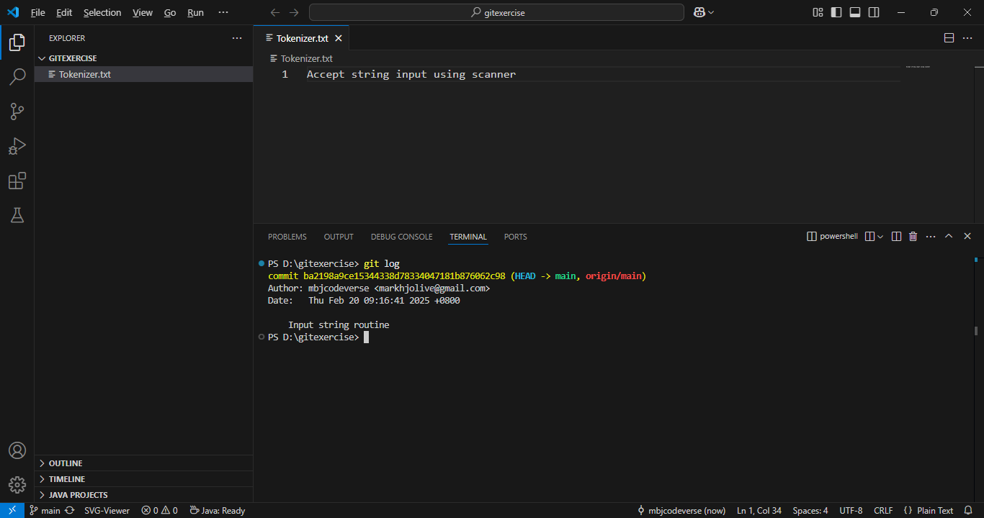

Slide 23
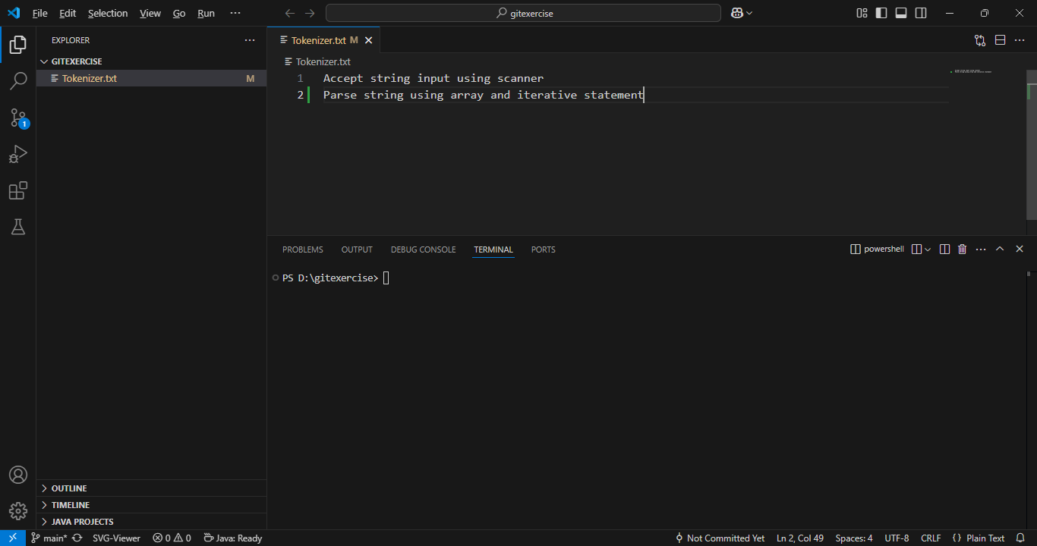

Slide 24
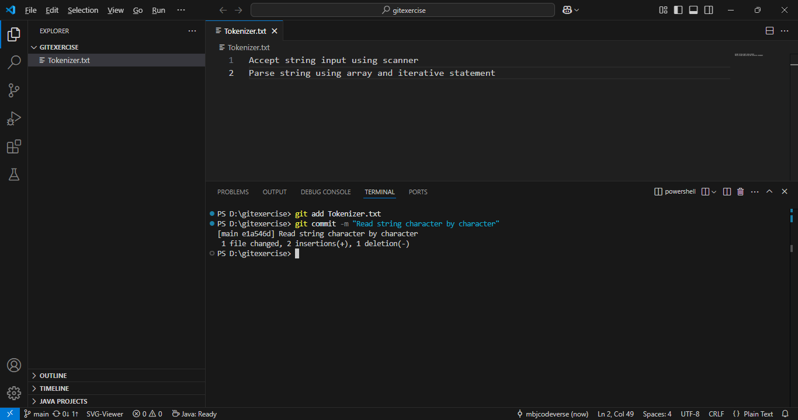

Slide 25
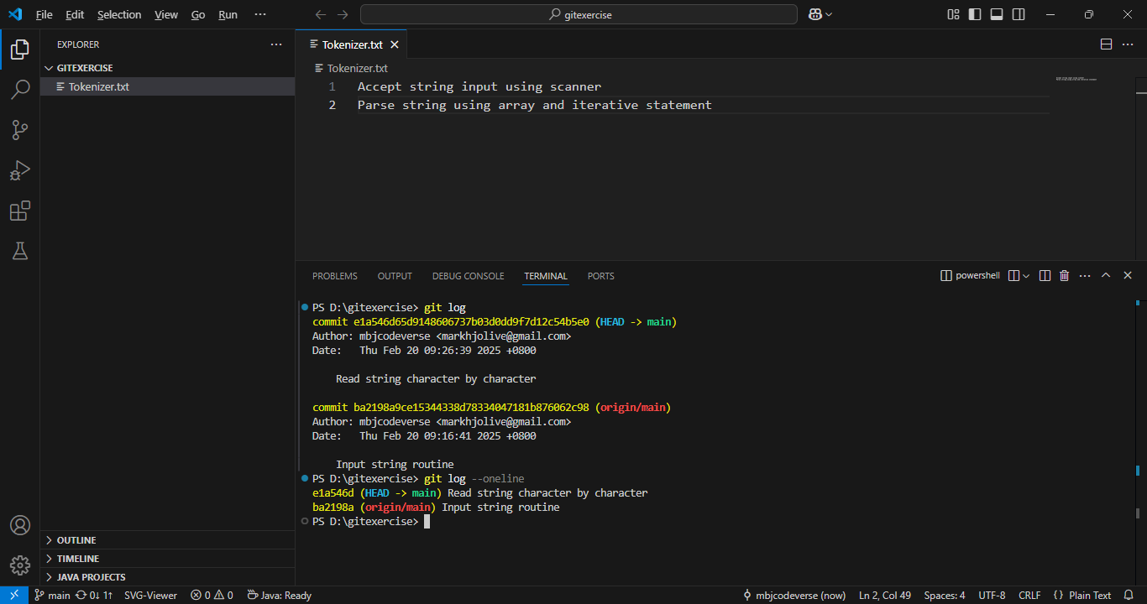

Slide 26
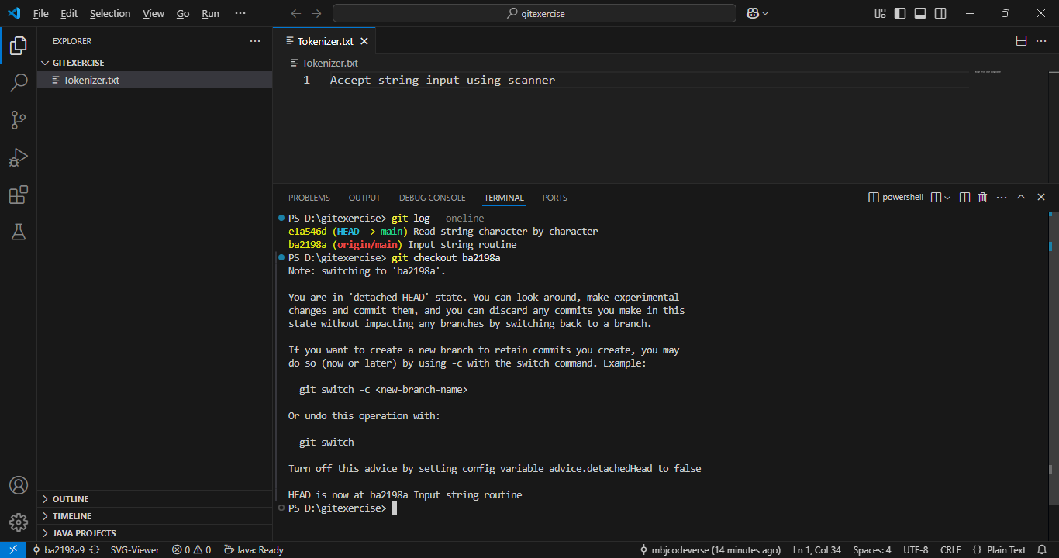

Slide 27
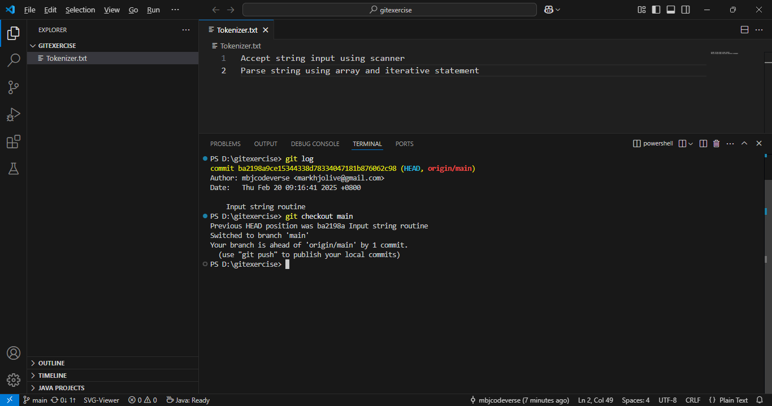

Slide 28
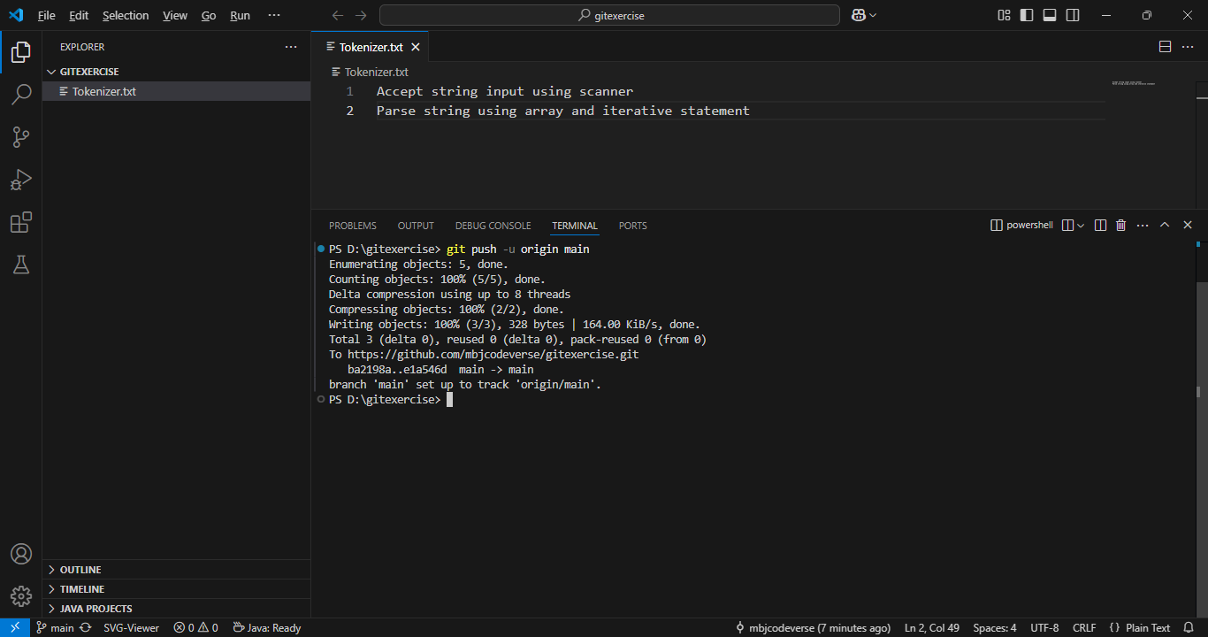

Slide 29
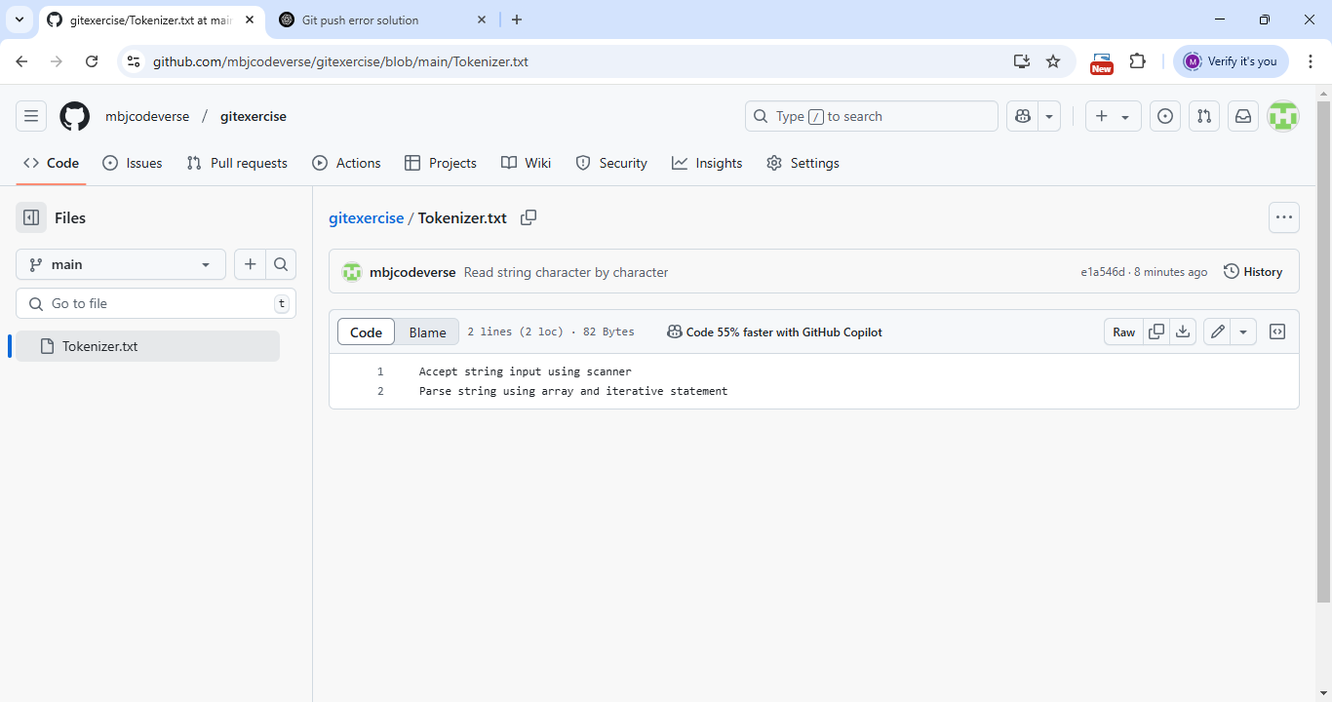

Slide 30
Git Restore

Slide 31
Day 4 Undoing Changes
Imagine you’ve been working on a file that is already part of a commit.
You know the code was working at the point of the last commit, however now the code is totally broken, and you just can’t seem to fix it.
You’ve written too much code to just run Ctrl+Z! How to fix this?

Slide 32
Day 4 Undoing Changes
Git restore
We can restore a file to its state at the previous most recent commit using the git restore command:
git restore file_name

Slide 33
Day 4 Undoing Changes
Git restore
We can restore a file to its state at the previous most recent commit using the git restore command:
git restore file_name
Warning:
You can not undo a git restore command, since your changes were not committed!

Slide 34
Day 4 Undoing Changes
Git restore
We can restore a file to its state at the previous most recent commit using the git restore command:
git restore file_name
Warning:
Think of this command as an ultimate “Ctrl+Z” restoring files to their previous commit.

Slide 35
Day 4 Undoing Changes
Git restore
Technically speaking git restore will restore the file back to the HEAD, which typically we have pointing to the most recent commit in the branch.

Slide 36
Day 4 Undoing Changes
Git restore
This actually gives us even more flexibility in our restore procedure, we can restore a file to any commit in the log.
We state the number of commits from the HEAD to go back to:
git restore --source HEAD~N file.txt

Slide 37
Day 4 Undoing Changes
Git restore
This actually gives us even more flexibility in our restore procedure, we can restore a file to any commit in the log.
We state the number of commits prior from the HEAD to go back to:
git restore --source HEAD~N file.txt

Slide 38
Day 4 Undoing Changes
Git restore
This actually gives us even more flexibility in our restore procedure, we can restore a file to any commit in the log.
We state the number of commits prior from the HEAD to go back to:
git restore --source HEAD~N file.txt

Slide 39
Day 4 Undoing Changes
Git restore
Finally, git restore also allows us to unstage files that we had already added to the staging area using git add.
We can do this with:
git restore --staged filename

Slide 40
Day 4 Undoing Changes
Let’s explore this command in practice:
git restore filename
git restore --source HEAD~N filename
git restore --staged filename

Slide 41
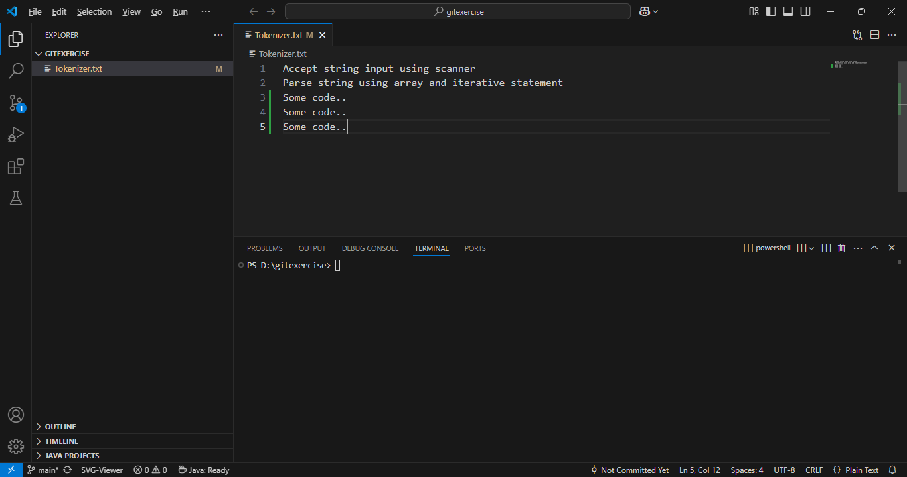

Slide 42
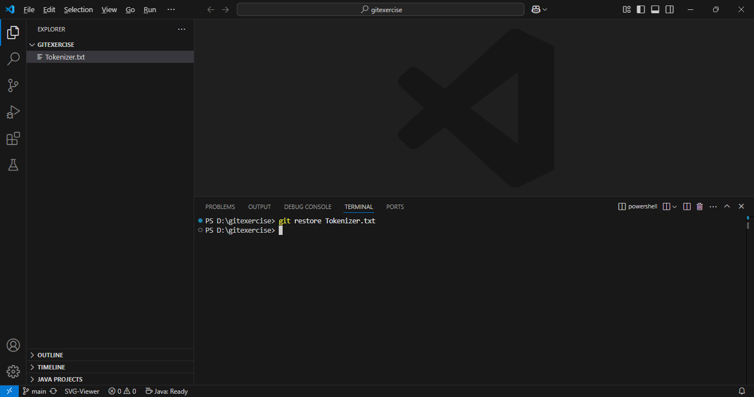

Slide 43
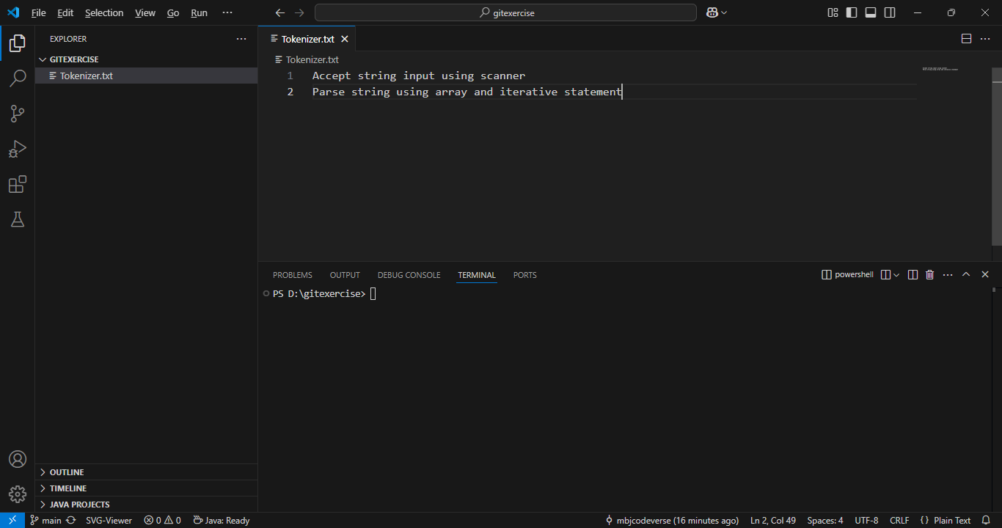

Slide 44
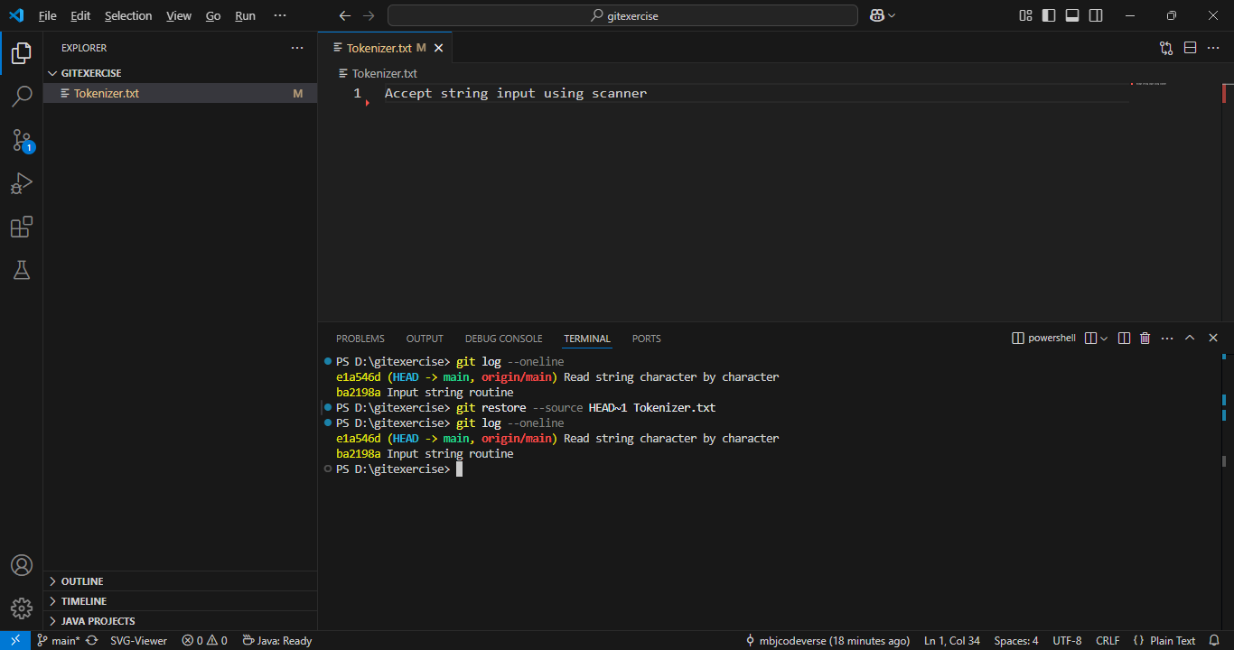

Slide 45
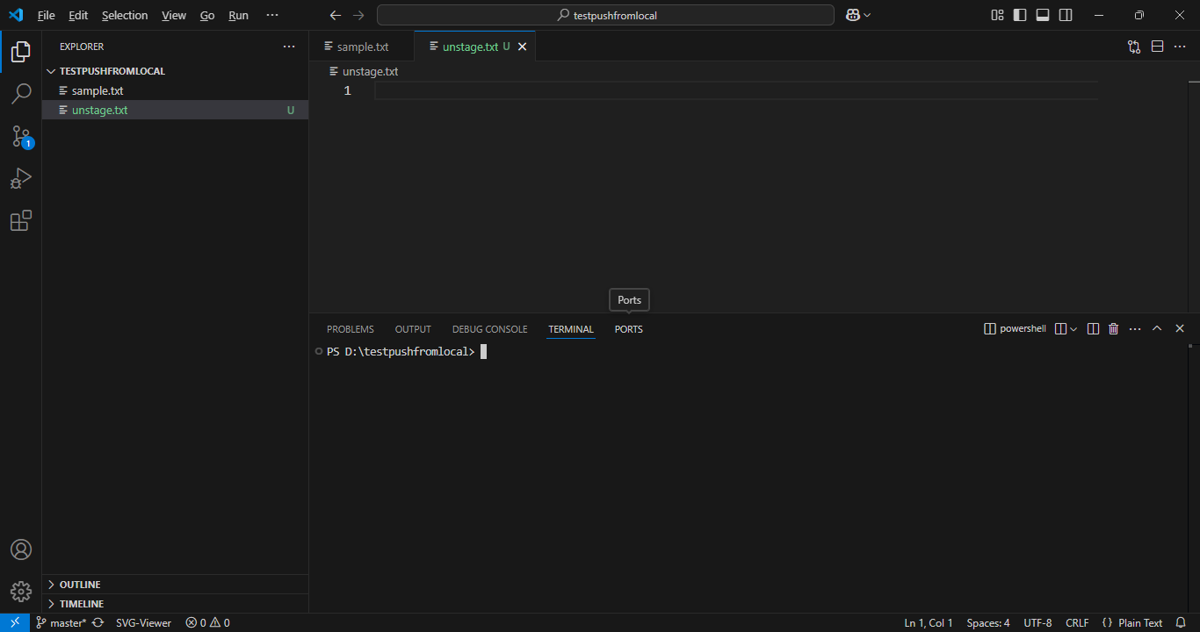
< unstaging file(s) >

Slide 46
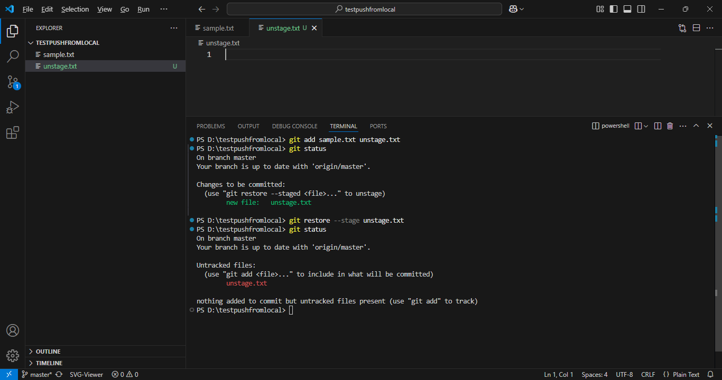

Slide 47
Day 4
Git Reset

Slide 48
Day 4 Undoing Changes
Git reset allows us to remove commits and “reset” the branch.
There are two main types of git reset calls:
git reset #######
Removes commits in front of the specific hash called, files unchanged.
git reset ####### --hard
Removes commits and the changes in the files.

Slide 49
Day 4 Undoing Changes
To fully understand this, let’s recall our discussions about working directory, staging area, and repository.

Slide 50


Day 4 Undoing Changes
Working Directory
Staging Area
Repository
program.py

Slide 51
Day 4 Undoing Changes
Working Directory
Staging Area
Repository
program.py

Slide 52
Day 4 Undoing Changes
Working Directory
Staging Area
Repository
program.py
“python code”
f3h4782

Slide 53
Day 4 Undoing Changes
Working Directory
Staging Area
Repository
program.py
“python code”
f3h4782
index.html
style.css

Slide 54
Day 4 Undoing Changes
Working Directory
Staging Area
Repository
program.py
“python code”
f3h4782
index.html
style.css

Slide 55
Day 4 Undoing Changes
Working Directory
Staging Area
Repository
program.py
“python code”
f3h4782
index.html
style.css
“style code”
g82j37l

Slide 56
Day 4 Undoing Changes
Working Directory
Staging Area
Repository
program.py
“python code”
f3h4782
index.html
style.css
“style code”
g82j37l

Slide 57
Day 4 Undoing Changes
Working Directory
Staging Area
Repository
program.py
“python code”
f3h4782
>>git reset f3h4782
index.html
style.css
“style code”
g82j37l

Slide 58
Day 4 Undoing Changes
Working Directory
Staging Area
Repository
program.py
“python code”
f3h4782
index.html
style.css

Slide 59
Day 4 Undoing Changes
Working Directory
Staging Area
Repository
Files are unchanged! You just reset the commits only.
program.py
“python code”
f3h4782
index.html
style.css

Slide 60
Day 4 Undoing Changes
This means when you do git reset you won’t notice a change in the files themselves, you just reset the commits.
This is useful if you accidentally committed to the wrong branch (for example, maybe you forgot to run git switch right after creating a new branch, accidentally committing to the original branch).

Slide 61
Day 4 Undoing Changes
What if you do want the files to change?
In the case where you just want to undo everything, including changes and have the branch files look like they did at a previous commit, you add the flag --hard.
For example:
git reset f3h4782 --hard

Slide 62
Day 4 Undoing Changes
Working Directory
Staging Area
Repository
program.py
“python code”
f3h4782
index.html
style.css
“style code”
g82j37l

Slide 63
Day 4 Undoing Changes
Working Directory
Staging Area
Repository
program.py
“python code”
f3h4782
>>git reset f3h4782 --hard
index.html
style.css
“style code”
g82j37l

Slide 64
Day 4 Undoing Changes
Working Directory
Staging Area
Repository
program.py
“python code”
f3h4782
>>git reset f3h4782 --hard

Slide 65
Day 4 Undoing Changes
We can visualize a git reset moving back to a previous commit, but not undoing file changes (unless it is --hard)
HEAD
Master
d34v8fh
a9jd3h7
vh2n38

Slide 66
Day 4 Undoing Changes
We can visualize a git reset moving back to a previous commit, but not undoing file changes (unless it is --hard)
HEAD
Master
d34v8fh
a9jd3h7
vh2n38

Slide 67
Day 4 Undoing Changes
We can visualize a git reset moving back to a previous commit, but not undoing file changes (unless it is --hard)
HEAD
Master
d34v8fh
a9jd3h7

Slide 68
Day 4 Undoing Changes
Can you undo a git reset --hard?
Technically you can try to recover a commit before Git does its garbage collection, however you should operate under the assumption that a --hard reset is not recoverable.

Slide 69
Day 4 Undoing Changes
Let’s explore examples of git reset!

Slide 70
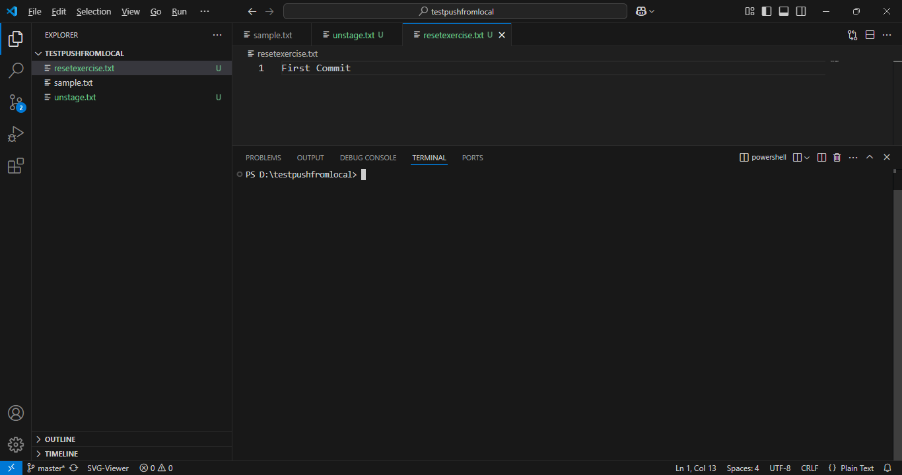

Slide 71
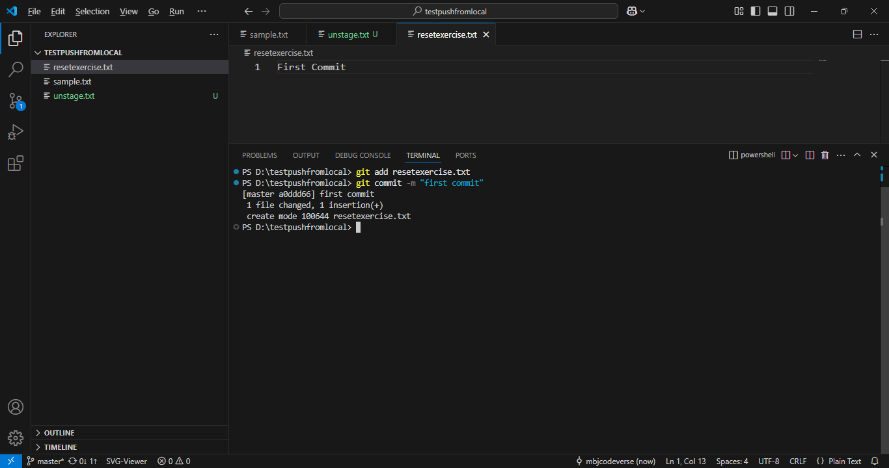

Slide 72
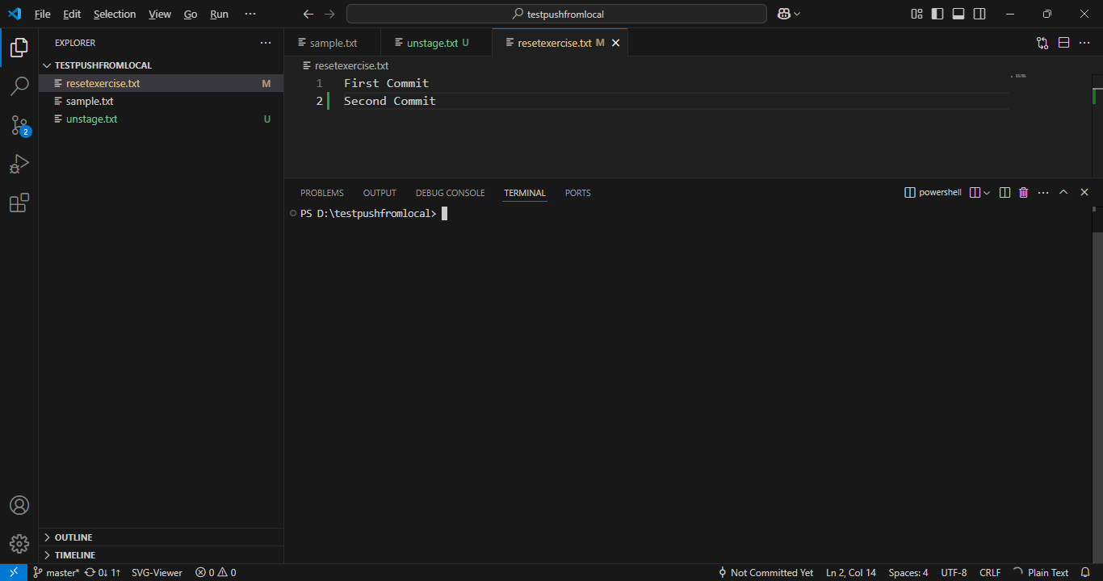

Slide 73
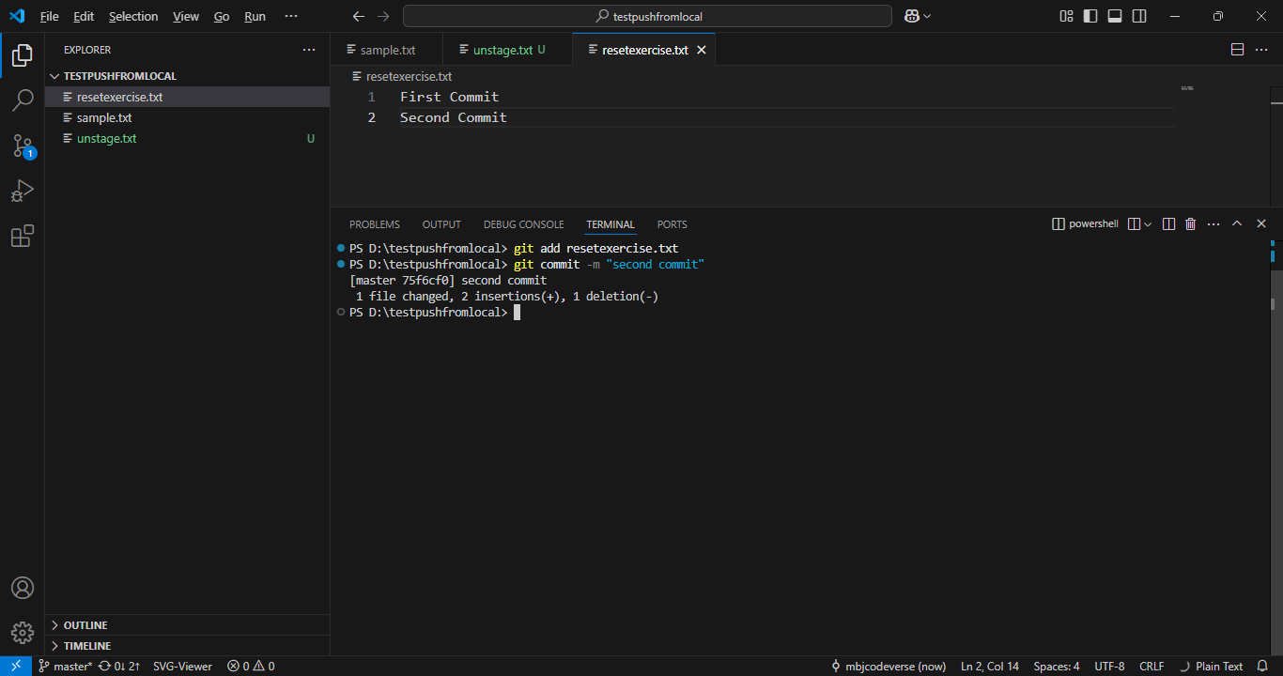

Slide 74
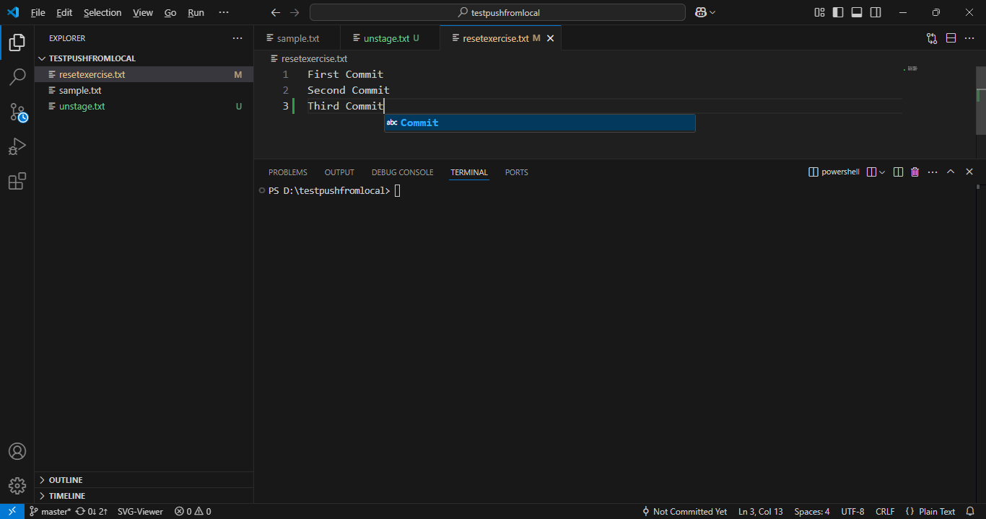

Slide 75
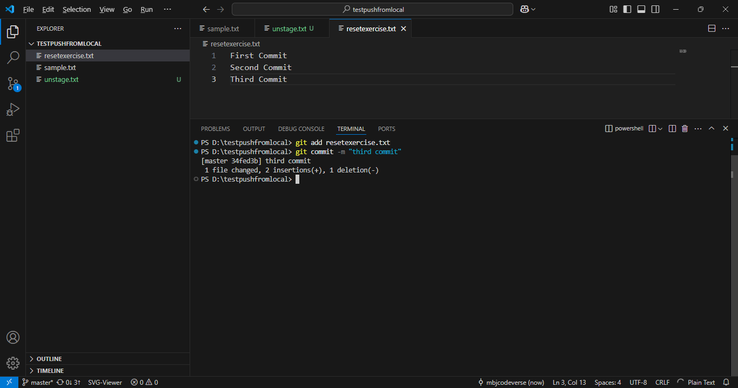

Slide 76
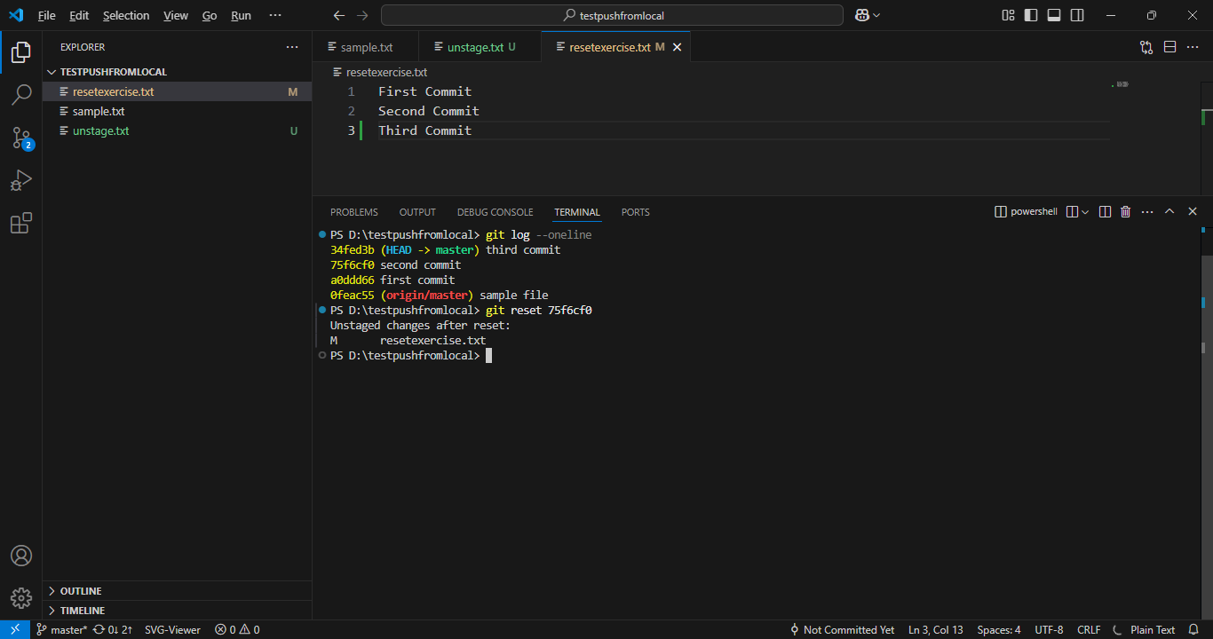

Slide 77
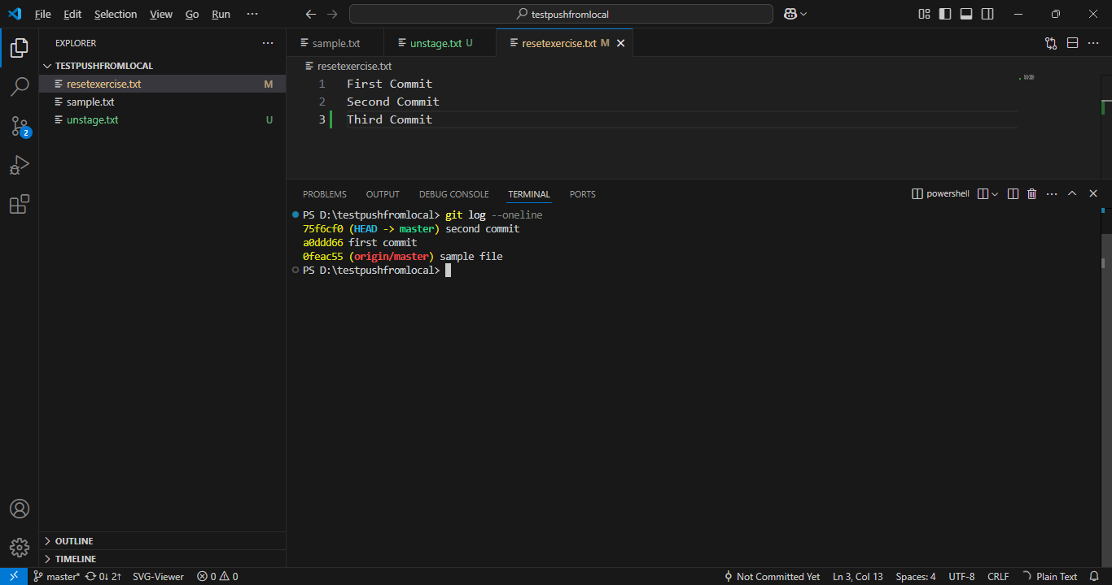
< code unchange >

Slide 78
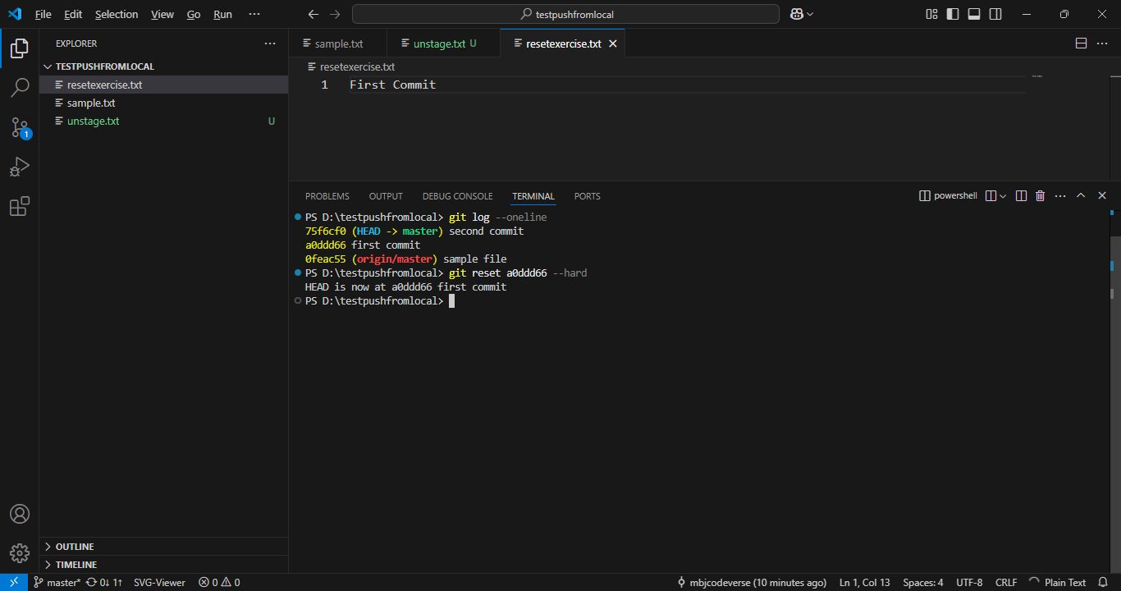

Slide 79
Day 4
Git Revert

Slide 80
Day 4 Undoing Changes
Let’s explore the last command for undoing changes, git revert.
The git revert command will create a new commit that undoes work from previous commits, but keeps those commits in the branch.

Slide 81
Day 4 Undoing Changes
Let’s review a git reset first.
A git reset goes back and removes the commits (and changes if its --hard)
HEAD
Master
d34v8fh
a9jd3h7
vh2n38
f6e2g4
zf3h49k

Slide 82
Day 4 Undoing Changes
Let’s review a git reset first.
A git reset goes back and removes the commits (and changes if its --hard)
HEAD
Master
d34v8fh
a9jd3h7
vh2n38
f6e2g4
zf3h49k

Slide 83
Day 4 Undoing Changes
Let’s review a git reset first.
A git reset goes back and removes the commits (and changes if its --hard)
HEAD
Master
d34v8fh
a9jd3h7
vh2n38

Slide 84
Day 4 Undoing Changes
Why could this be an issue?
You can lose shared history!
HEAD
Master
d34v8fh
a9jd3h7
vh2n38

Slide 85
Day 4 Undoing Changes
Why could this be an issue?
You can lose shared history!
HEAD
Master
d34v8fh
a9jd3h7
vh2n38
f6e2g4
zf3h49k
Other branch commit
Other

Slide 86
Day 4 Undoing Changes
Why could this be an issue?
You can lose shared history!
HEAD
Master
d34v8fh
a9jd3h7
vh2n38
f6e2g4
zf3h49k
Other branch commit
Other

Slide 87
Day 4 Undoing Changes
Why could this be an issue?
You can lose shared history!
HEAD
Master
d34v8fh
a9jd3h7
vh2n38
f6e2g4
zf3h49k
Other branch commit
Other

Slide 88
Day 4 Undoing Changes
This makes a merge of the branches harder!
HEAD
Master
d34v8fh
a9jd3h7
vh2n38
f6e2g4
zf3h49k
Other branch commit
Other

Slide 89
Day 4 Undoing Changes
A git revert creates a new commit that matches the historical state of a previous commit.
HEAD
Master
d34v8fh
a9jd3h7
vh2n38
f6e2g4
zf3h49k

Slide 90
Day 4 Undoing Changes
Git revert doesn’t change the project history, which makes it a “safe” operation for commits that have already been published to a shared repository.

Slide 91
Day 4 Undoing Changes
A git revert creates a new commit that matches the historical state of a previous commit.
HEAD
Master
d34v8fh
a9jd3h7
vh2n38
f6e2g4
zf3h49k

Slide 92
Day 4 Undoing Changes
A git revert creates a new commit that matches the historical state of a previous commit.
HEAD
Master
d34v8fh
a9jd3h7
vh2n38
f6e2g4
zf3h49k

Slide 93
Day 4 Undoing Changes
A git revert creates a new commit that matches the historical state of a previous commit.
HEAD
Master
d34v8fh
a9jd3h7
vh2n38
f6e2g4
zf3h49k
NEW

Slide 94
Day 4 Undoing Changes
A git revert creates a new commit that matches the historical state of a previous commit.
HEAD
Master
d34v8fh
a9jd3h7
vh2n38
f6e2g4
zf3h49k
NEW

Slide 95
Day 4 Undoing Changes
The git revert command is a forward-moving undo operation that offers a safe method of undoing changes. Instead of deleting or orphaning commits in the commit history, a revert will create a new commit that inverses the changes specified.
HEAD
Master
d34v8fh
a9jd3h7
vh2n38
f6e2g4
zf3h49k
NEW

Slide 96
Day 4 Undoing Changes
Git revert is a safer alternative to git reset in regards to losing work.
HEAD
Master
d34v8fh
a9jd3h7
vh2n38
f6e2g4
zf3h49k
NEW

Slide 97
Day 4 Undoing Changes
Let’s explore an example of git revert!

Slide 98
Day 4
Exercises and Solution

Slide 99
Day 4 Undoing Changes
Let’s test your skills with the Git’s “undo” set of commands.
Note:
You will definitely want to reference the documentation or our lectures to remember the differences between restore, revert, and reset!

Slide 100
Day 4 Undoing Changes
TASKS:
Clone the repository at this URL:
https://github.com/Pierian-Data/day-four-undo-exercise-file
View the historical commits and confirm the name of the branch.

Slide 101
Day 4 Undoing Changes
TASKS:
Without permanently changing the content of the file at any commit, view what the file looked like after the “first commit”. This should give you a Detached HEAD at the first commit.
After viewing the file, move the HEAD back to the current main branch (most recent commit).

Slide 102
Day 4 Undoing Changes
Go back to commit with message “second commit” and create a new branch called new_branch starting from that point (do not delete commits that came after this one).
Stay on the main branch pretend like you “forgot” to switch to your new branch.

Slide 103
Day 4 Undoing Changes
While on the main branch at the second commit, delete everything in the file using the text editor and your delete key.
Now using Git commands only (not just Ctrl+Z) restore the file so it matches what it looked like at the second commit (right before you deleted everything).

Slide 104
Day 4 Undoing Changes
While still on the main branch at the second commit, add a new line that says “new branch text”.
Add and Commit this change to the file.
Realize that you meant to actually do this change on your new_branch, figure out how to undo the commit on the main branch without losing your work, then switch branches and do the add/commit.

Slide 105
Day 4 Undoing Changes
Note!
This repository was initially created on GitHub, meaning the master branch is actually called main.
Keep this in mind as you switch or checkout branches.
PAUSE THE VIDEO NOW IF YOU DON’T WANT TO SEE THE SOLUTIONS!

Slide 106
Day 4 Undoing Changes
Solution:
git log --oneline
git checkout 5f2f515
git checkout main or git switch main
git checkout 461e423
git branch new_branch
git restore myfile.txt
git commit -a -m “new branch text”
git reset 1d9c172
git switch new_branch
git commit -a -m “fixed new branch text”

